Slide 1

Selenium Tests for Orange.ro
Cristina Iarosevici

Slide 2
Purpose of the tests
In order to ensure the proper that the website is running according to specs, and the required functionality is met the following test cases were developed: 1. TC_1 – Ensure that the homepage navigation buttons are working as expected
2. TC_2 – Selecting and adding phone subscription to cart
3. TC_3 – Search phone and add to cart
4. TC_4 – Search accessories and add to cart
5. TC_5 – Adding to cart and completing order
6. TC_6 – Ensure that Functionality of the log in page is working

Slide 3
TC_1 Homepage
In this test case I verified that the main buttons from homepage (Personal, Companies, Contact, Shop, etc.) are working properly and I subscribe to newsletter

Slide 4
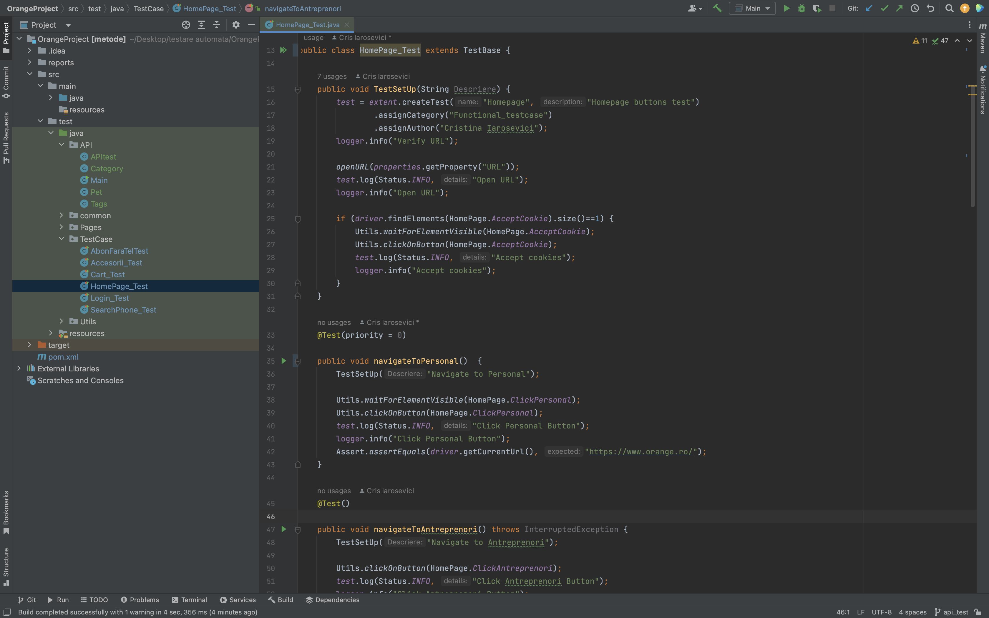
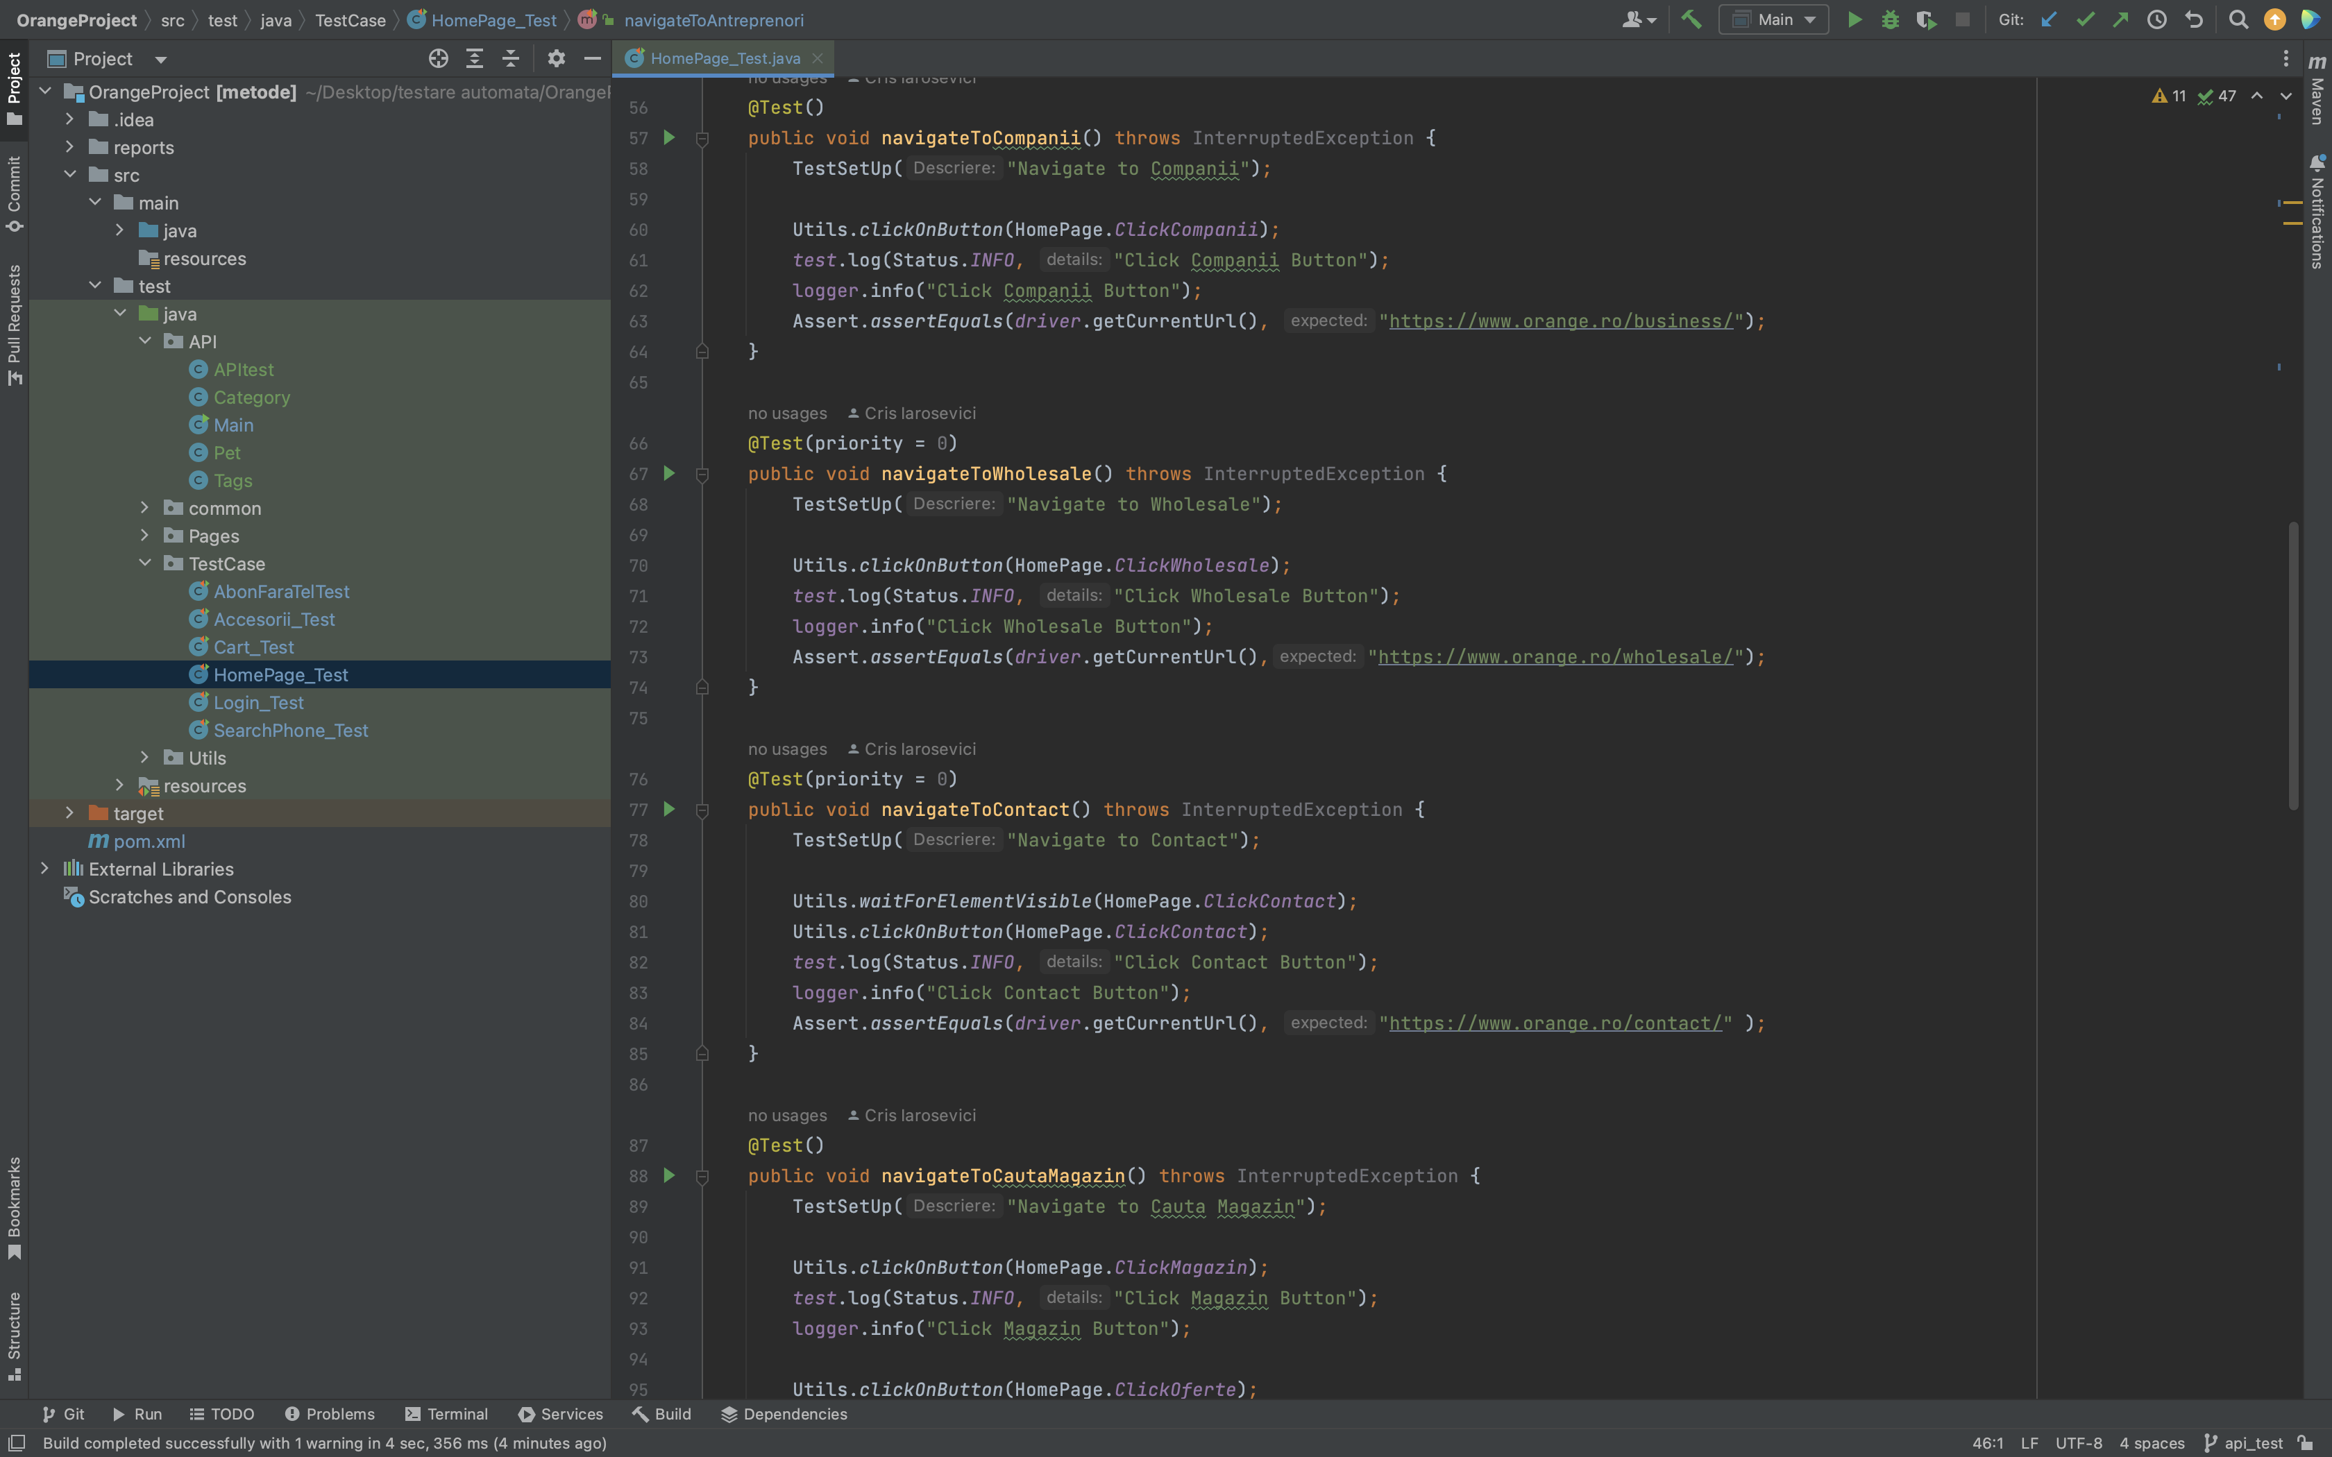
Code print screen

Slide 5
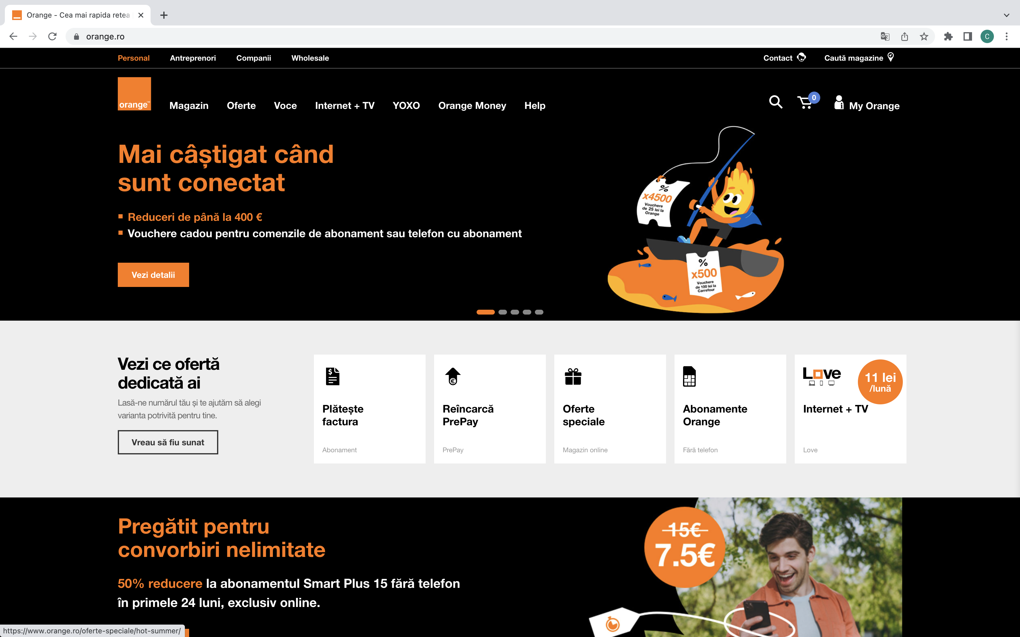
Site Print Screen

Slide 6
TC_2 Abonament
In this test case I select and add a phone subscription to cart from the offers that appear on the subscriptions page

Slide 7
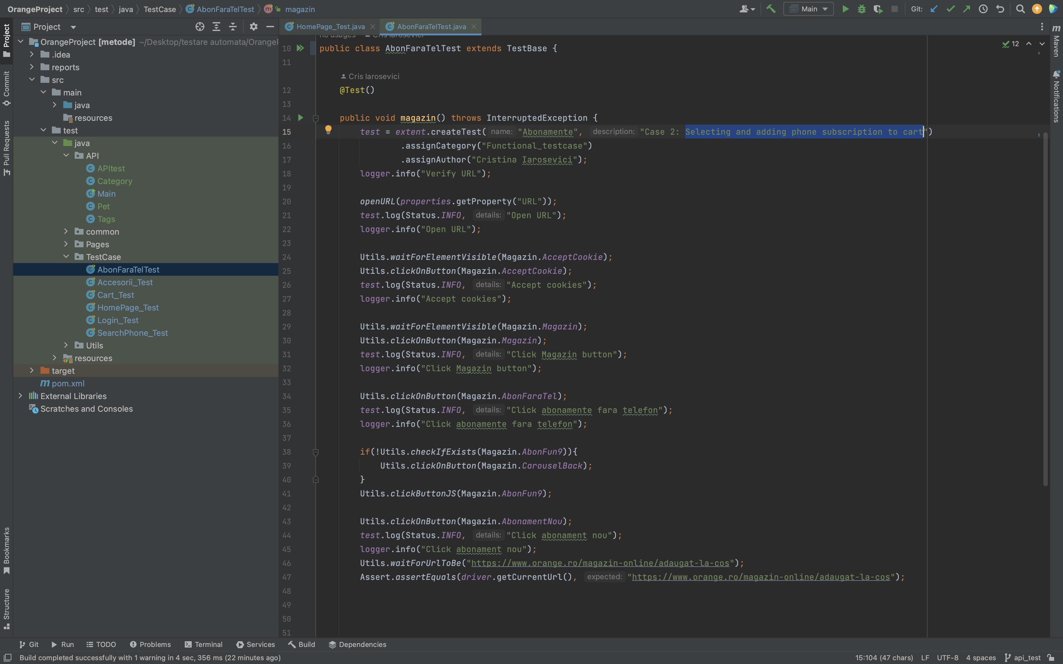
Code print screen

Slide 8
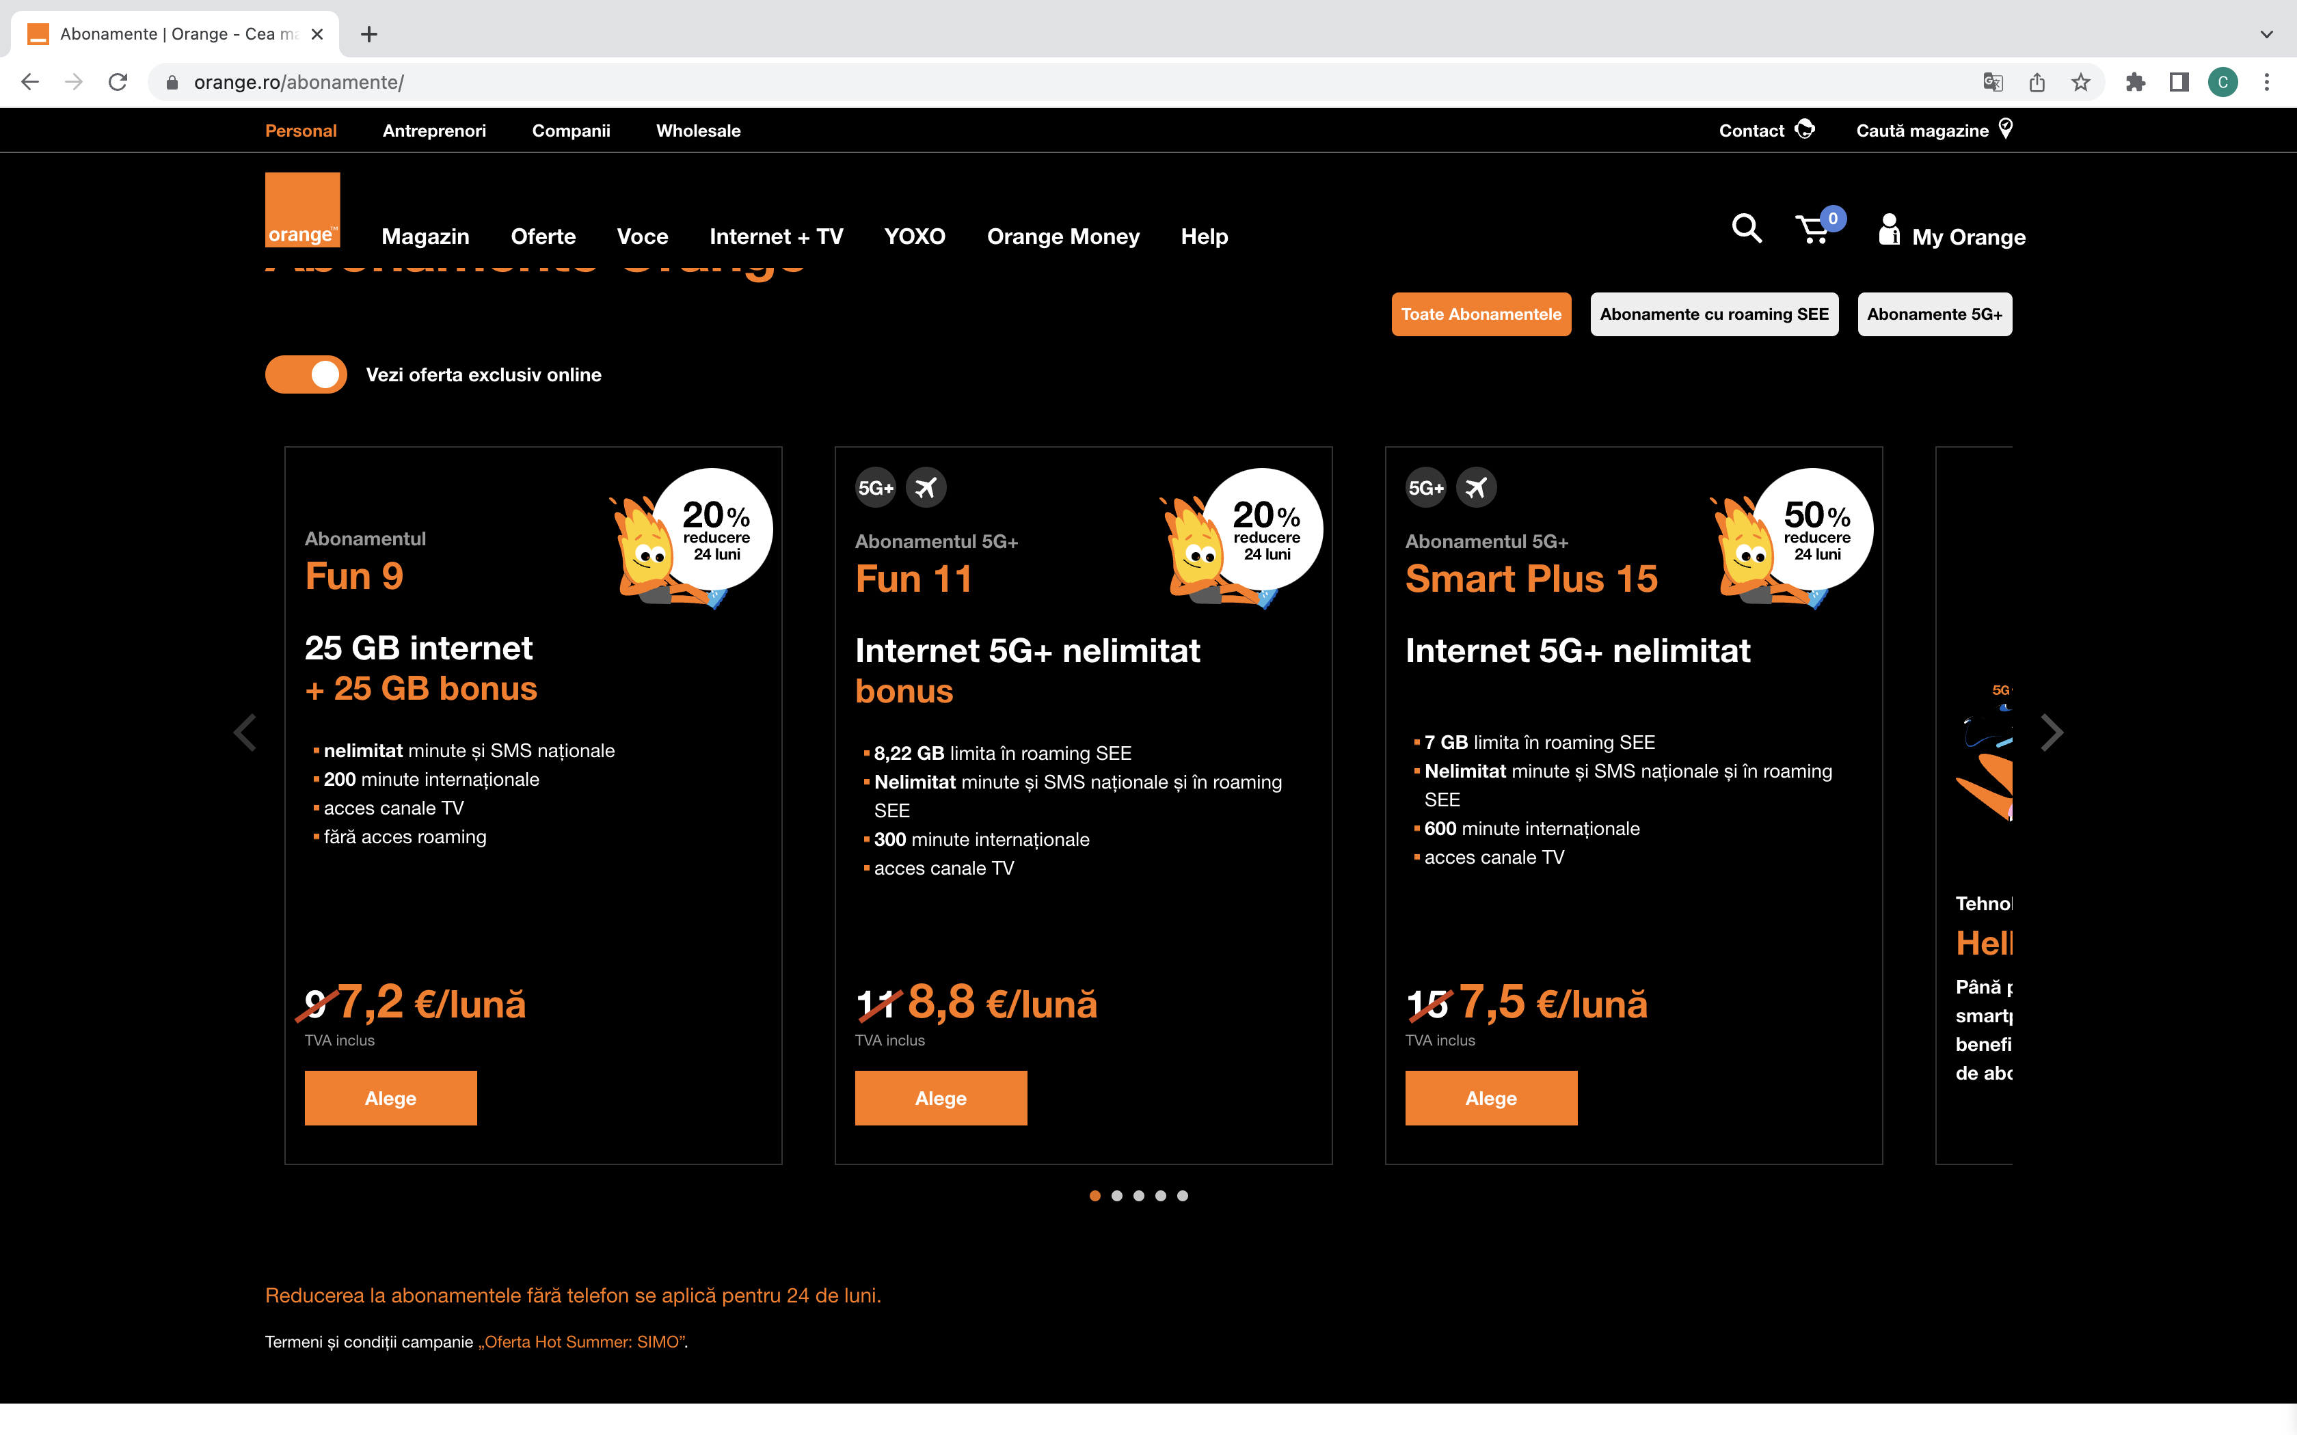
Site Print Screen

Slide 9
TC_3 Search phone and add to cart
In this test case I search for a phone using the filters and add it to the cart

Slide 10
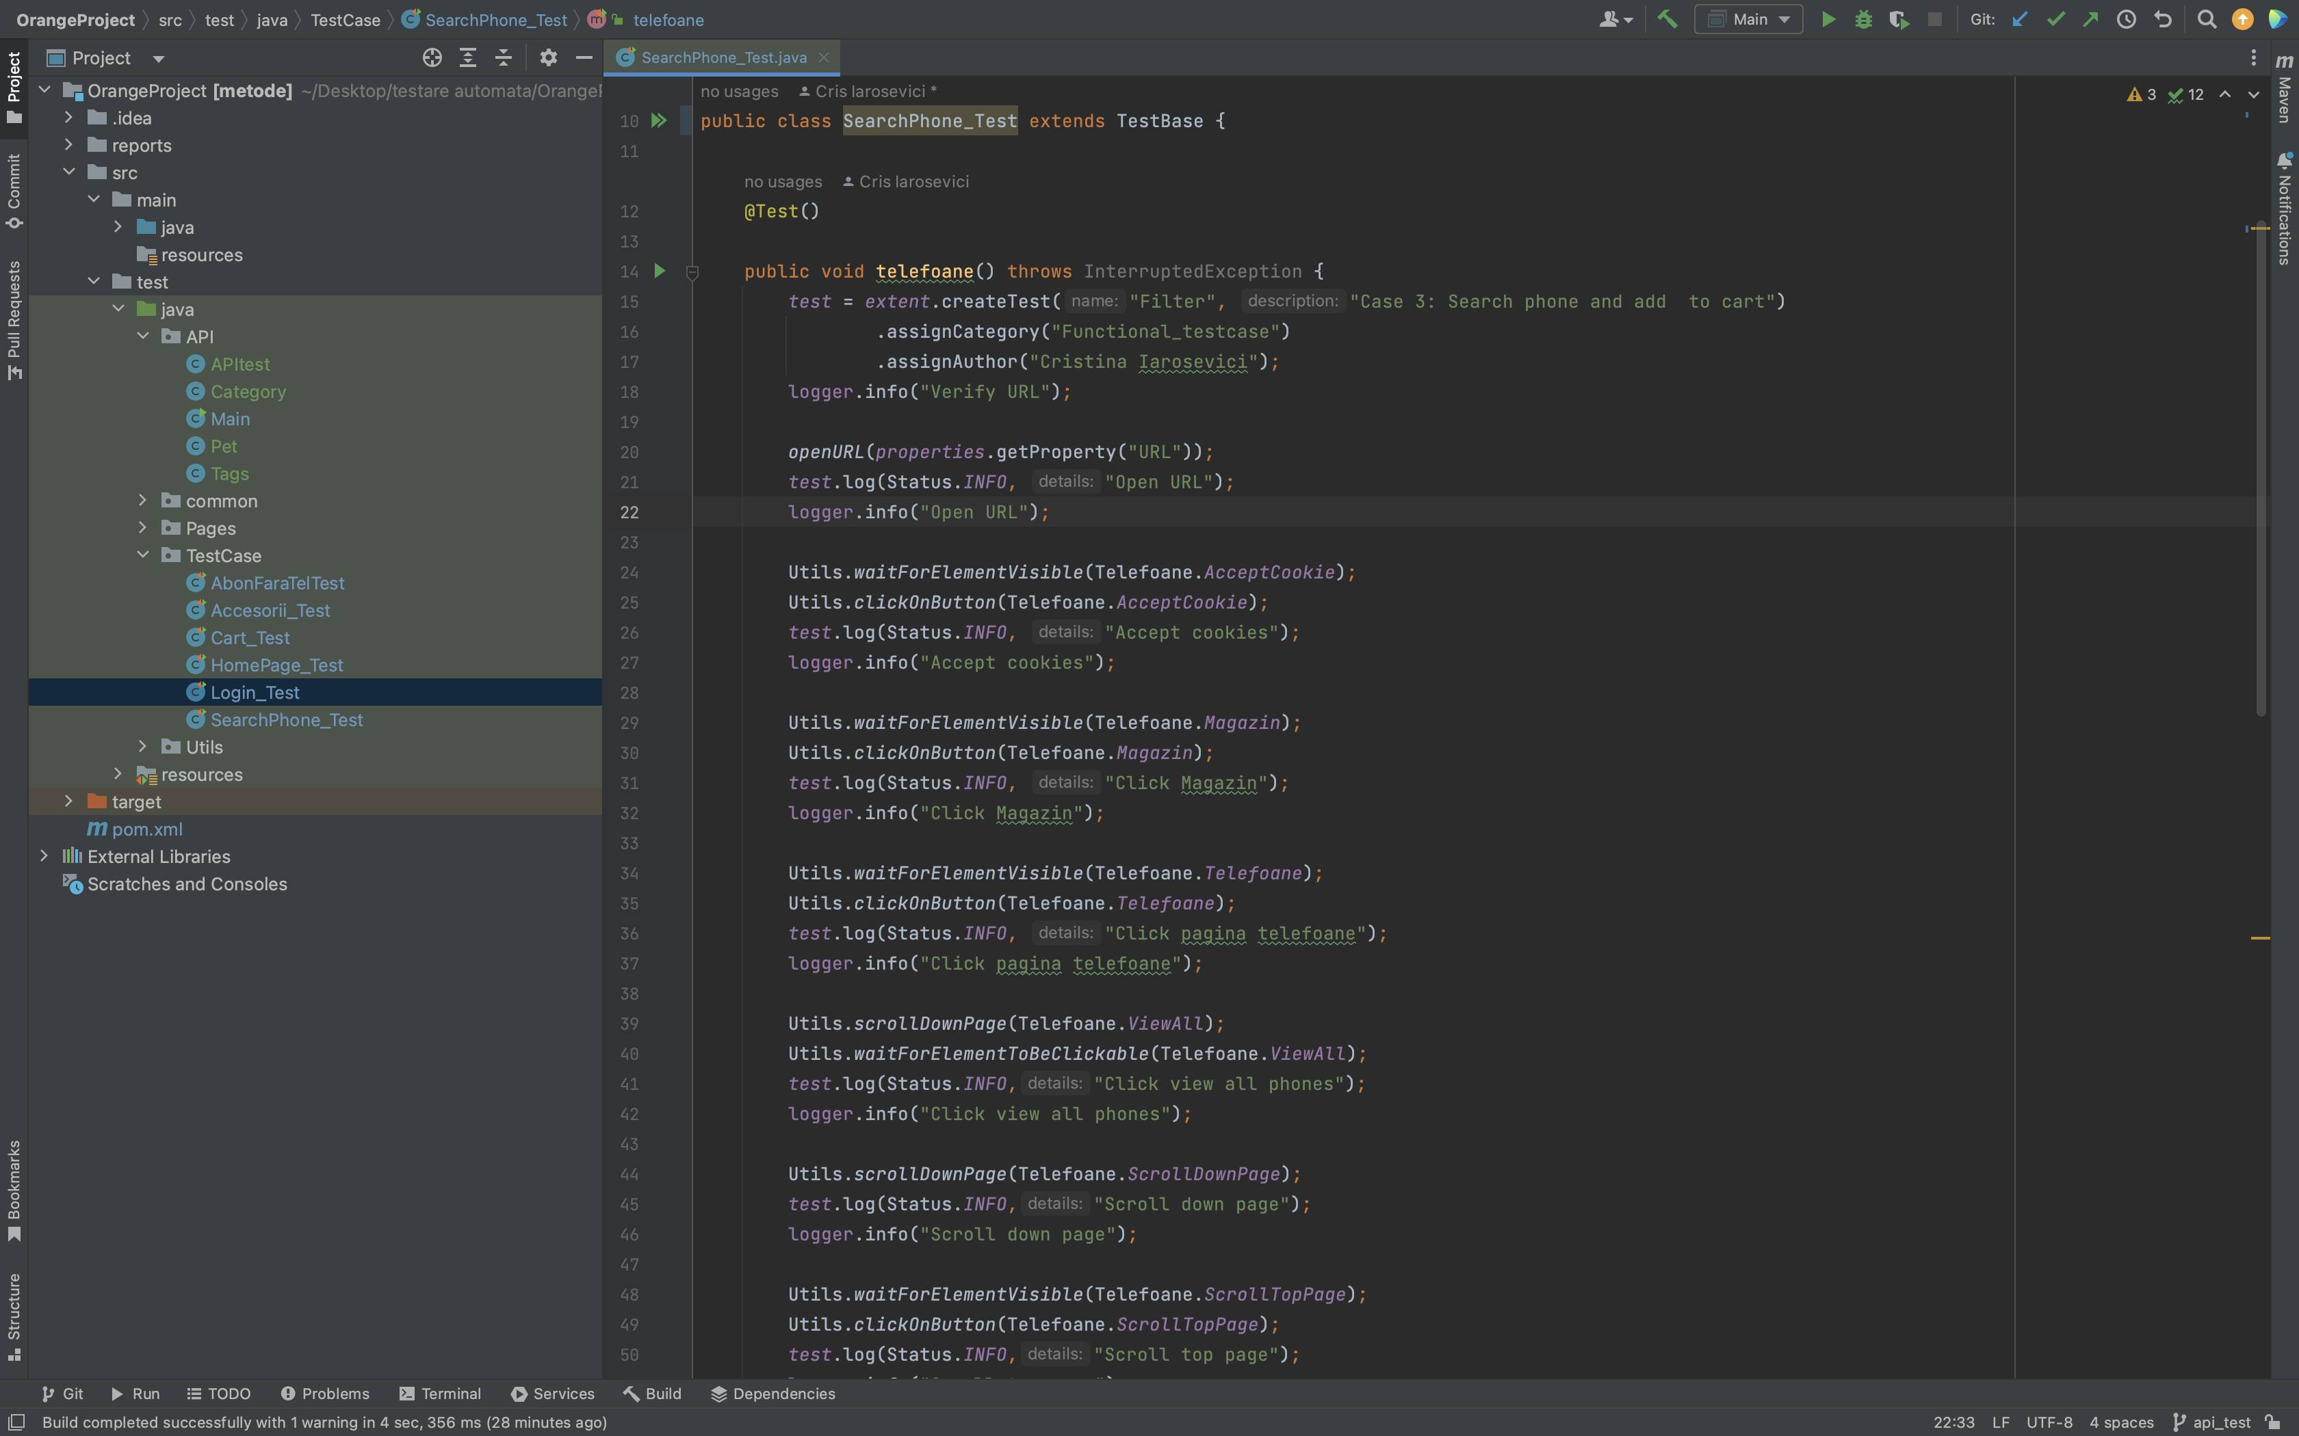
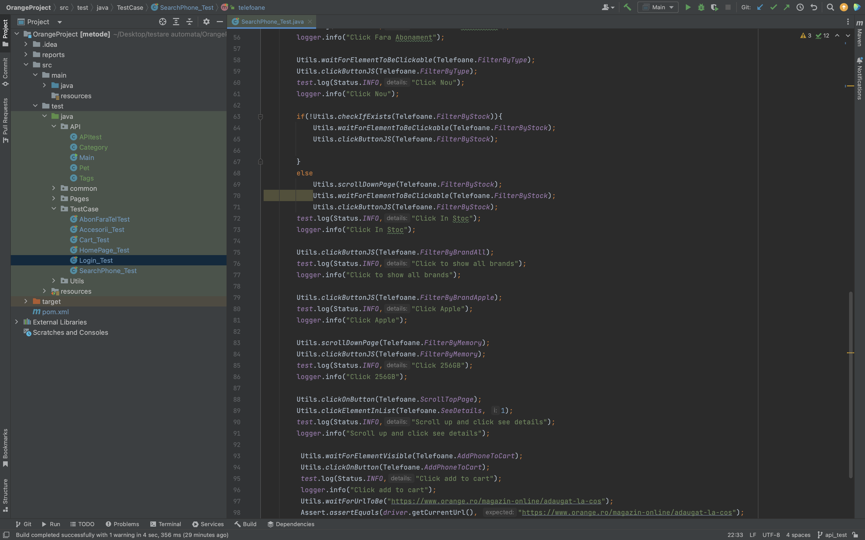
Code print screen

Slide 11
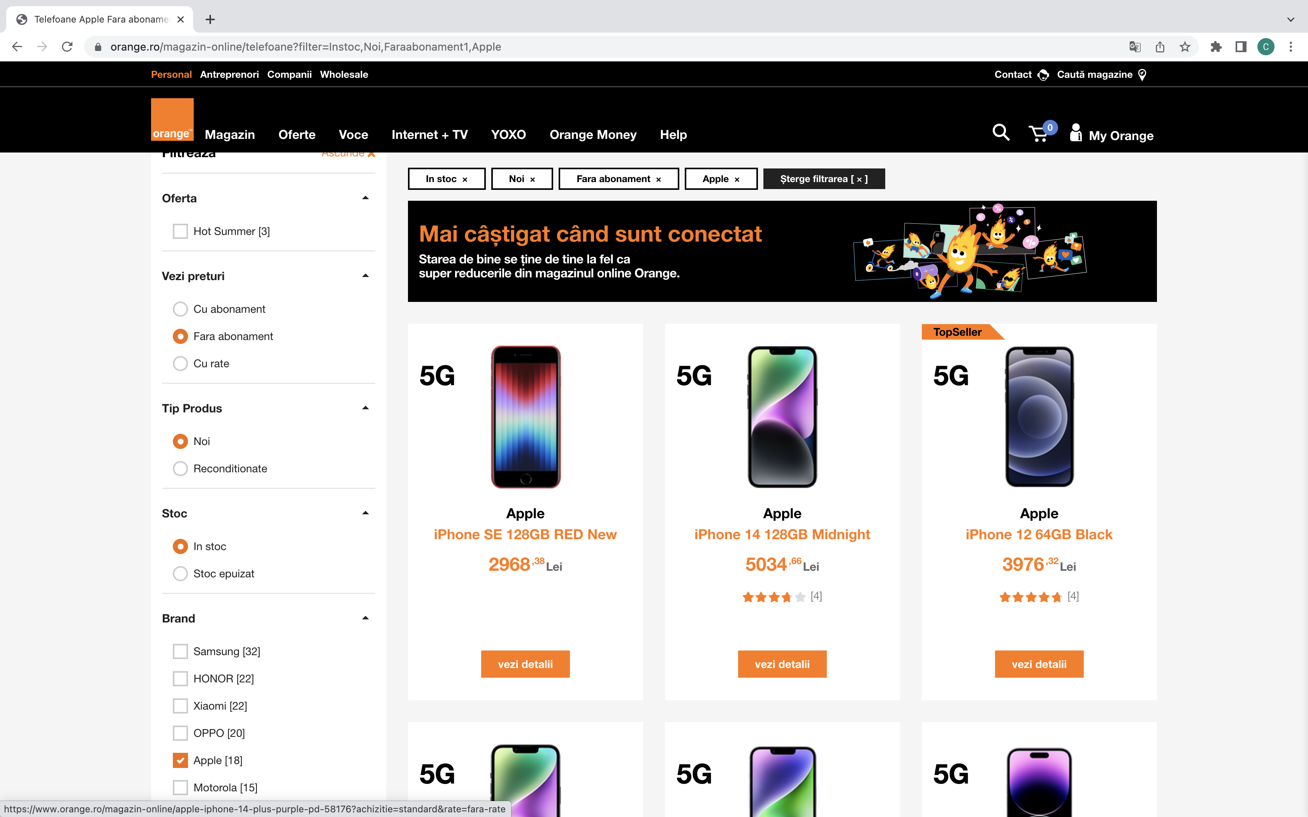
Site Print Screen

Slide 12
TC_4 – Search and add accessories to cart
In this test case I test the accessories page. Using filters I select and add a phone adapter to cart

Slide 13
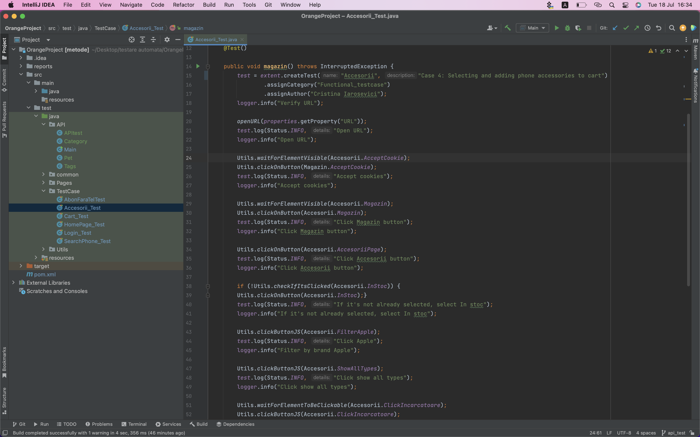
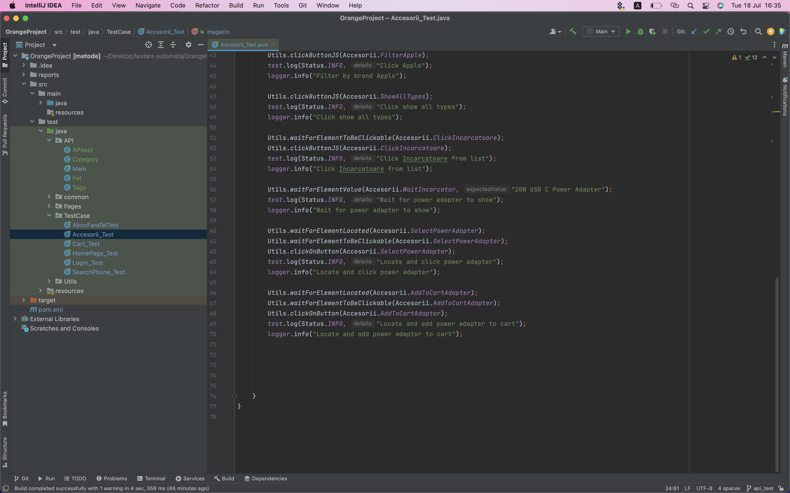
Code print screen

Slide 14
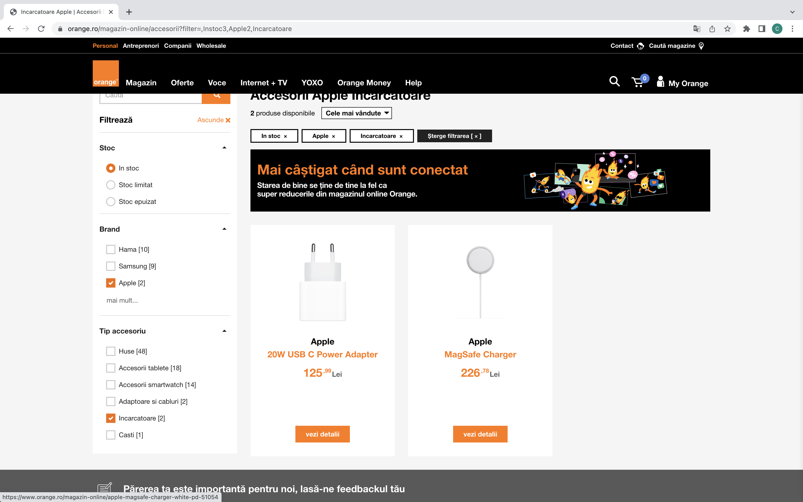
Site Print Screen

Slide 15
TC_5 – Adding to cart and completing order
This test case is about the functionality of the cart. I add a product to cart and submit all the details in the order form.

Slide 16
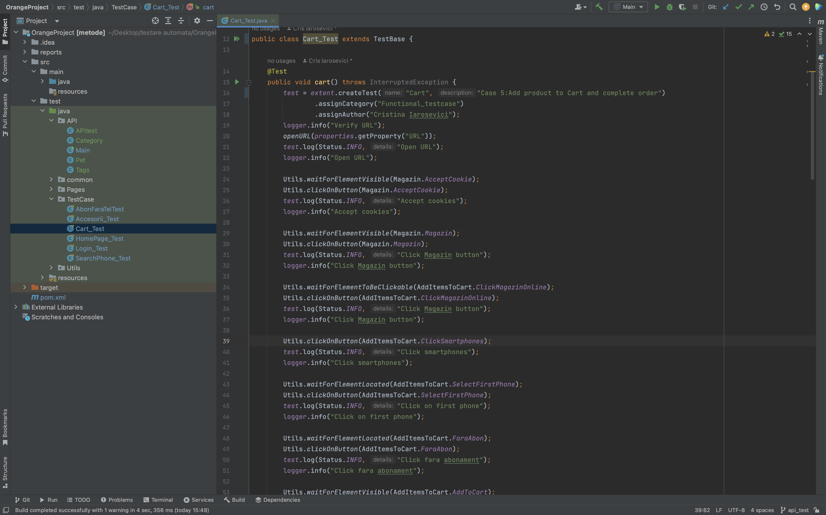
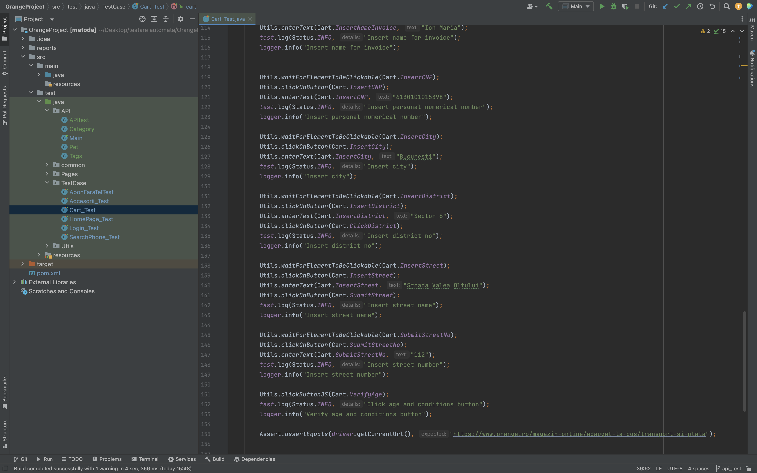
Code print screen

Slide 17
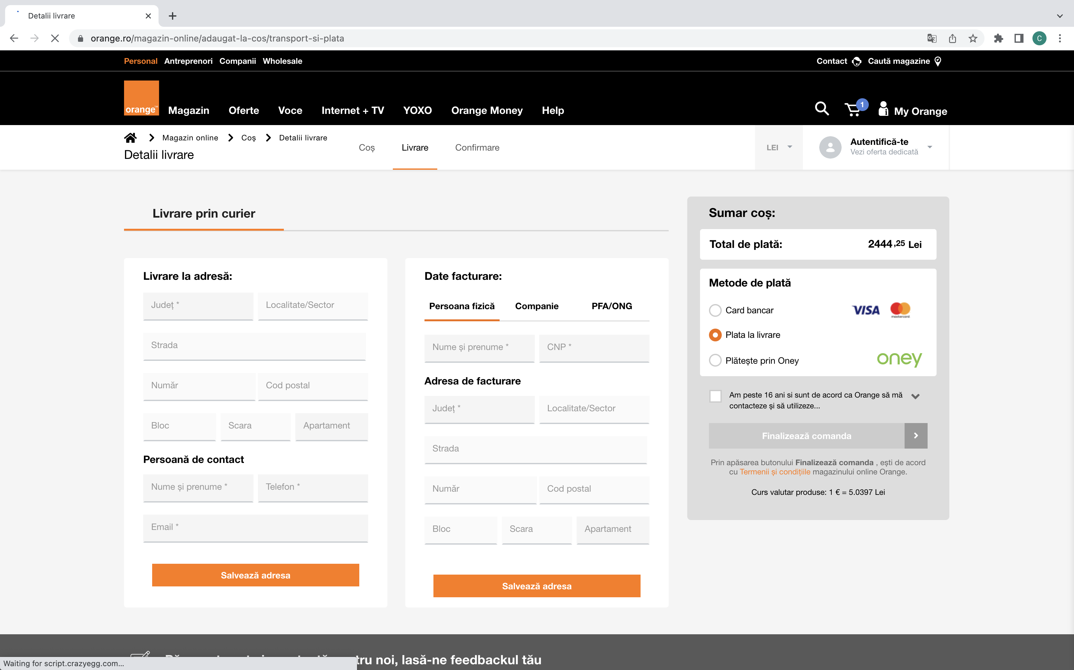
Site Print Screen

Slide 18
TC_6 – Login Page
In this test case I ensure that the functionality of the log in page is working

Slide 19
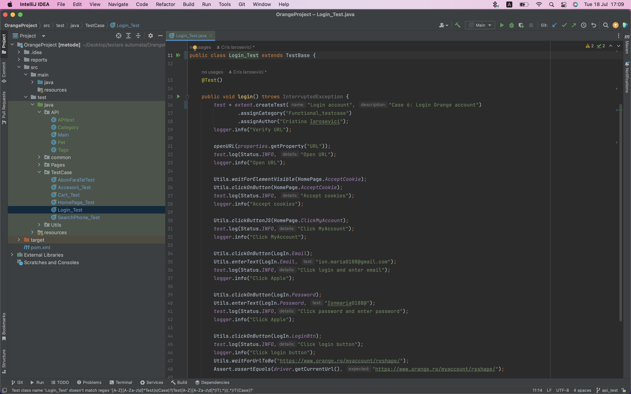
Code print screen

Slide 20
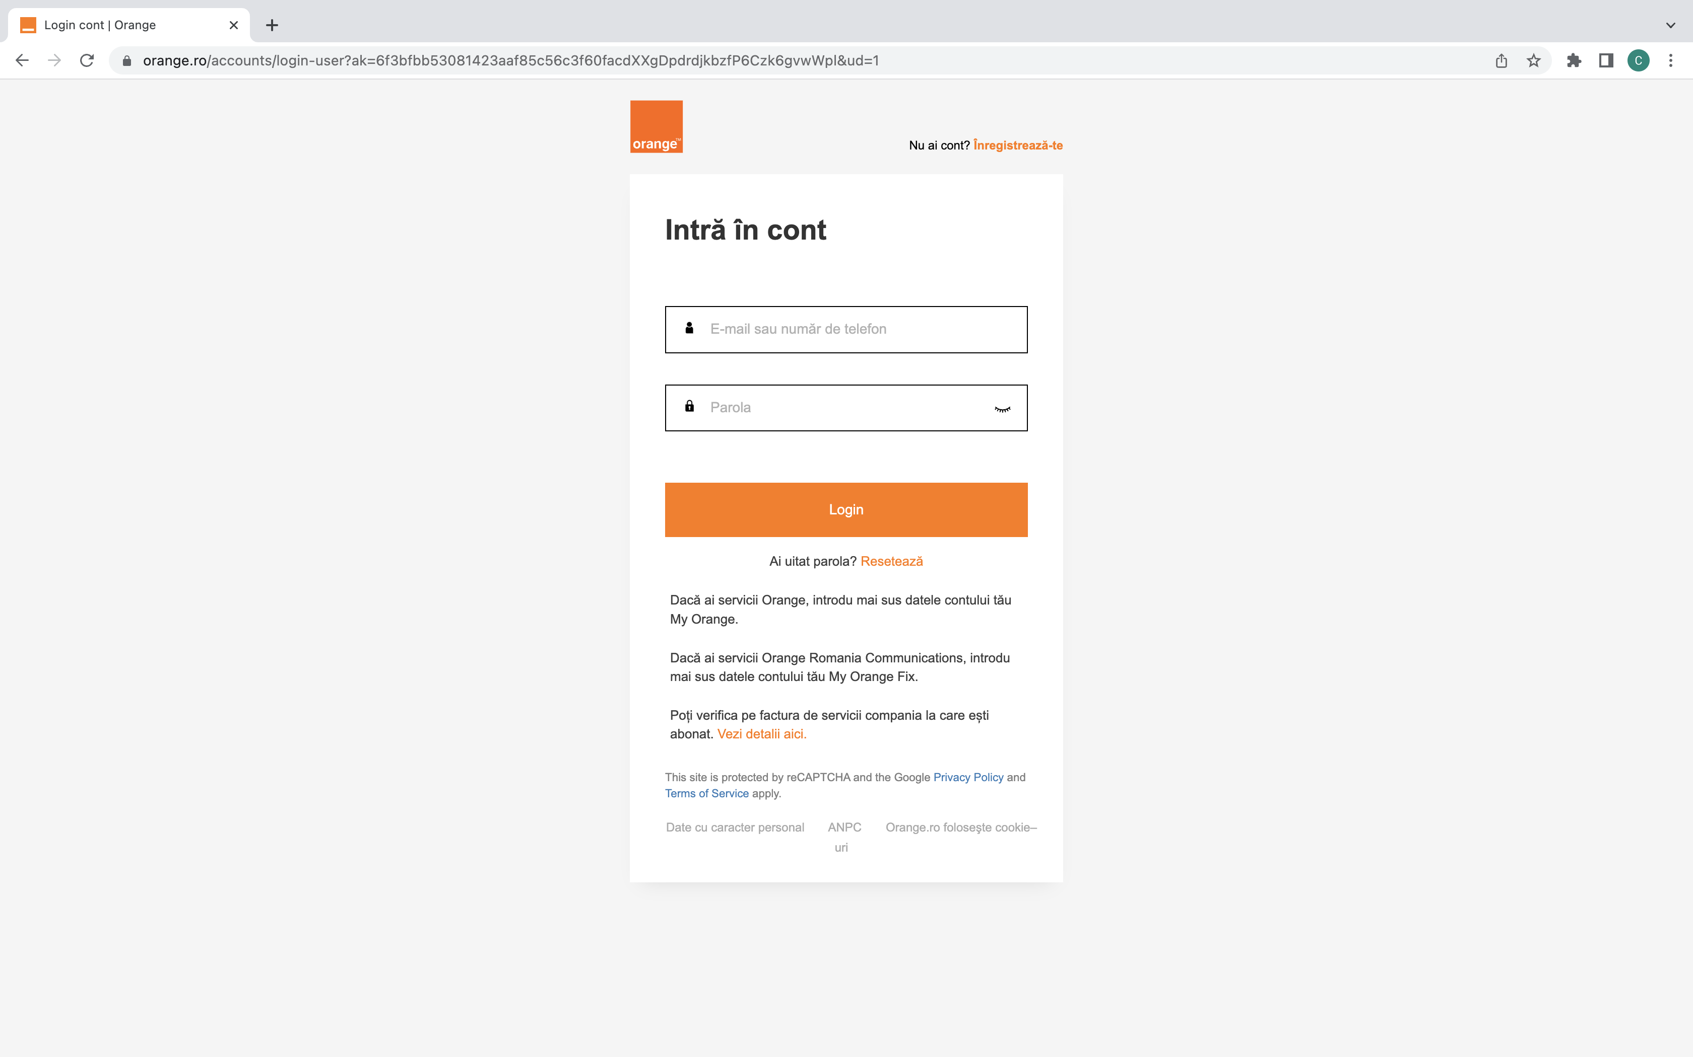
Site Print Screen

